Slide 1
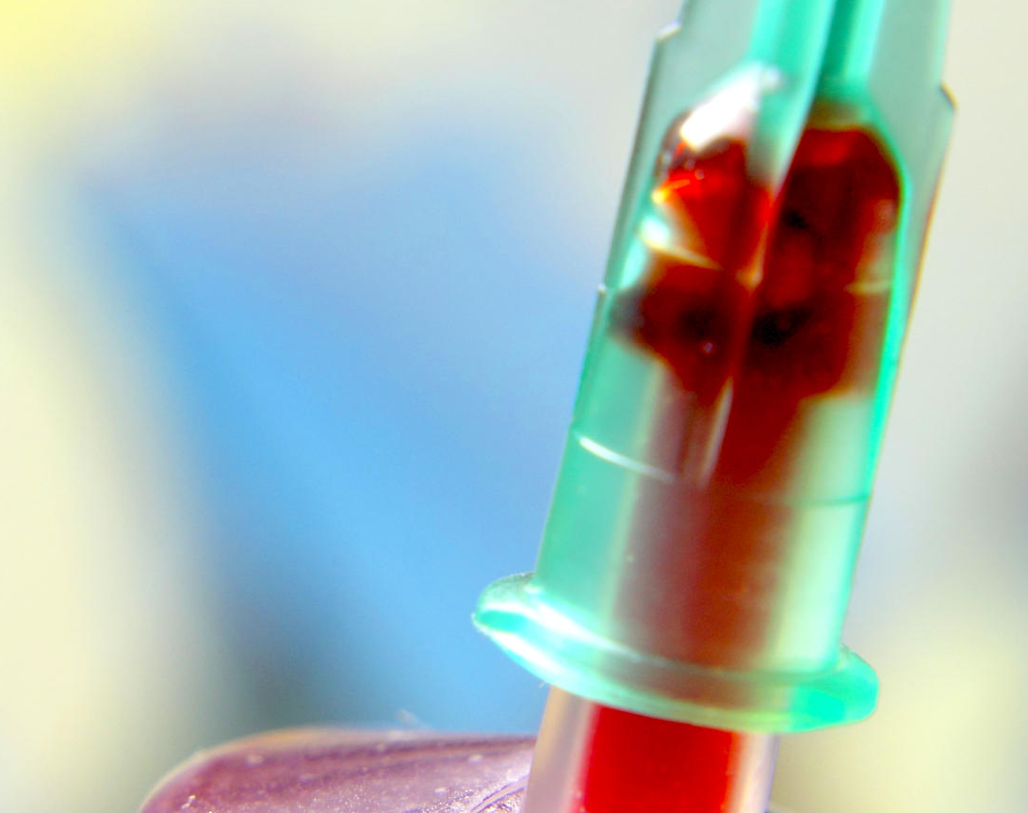
Blood Donation
Management System
Submitted by :
Alifun Nahar (19101033)
Nishat Tasnim Tanah (19101036)
This Photo by Unknown author is licensed under CC BY.

Slide 2
Project Ideas
The details of the patient like Id ,Name , Age, Blood group etc. will be maintained in the Blood Donation Management System Database .
In this Database system a patient can able to find his/her blood group from nearest blood bank.
We can able to get all the information of blood bank from this database.
If we cannot find the expected blood from the blood bank we can contact with the donor .

Slide 3

Project Content
Patient
Donor
Blood Bank
Blood Storage
Price

Slide 4
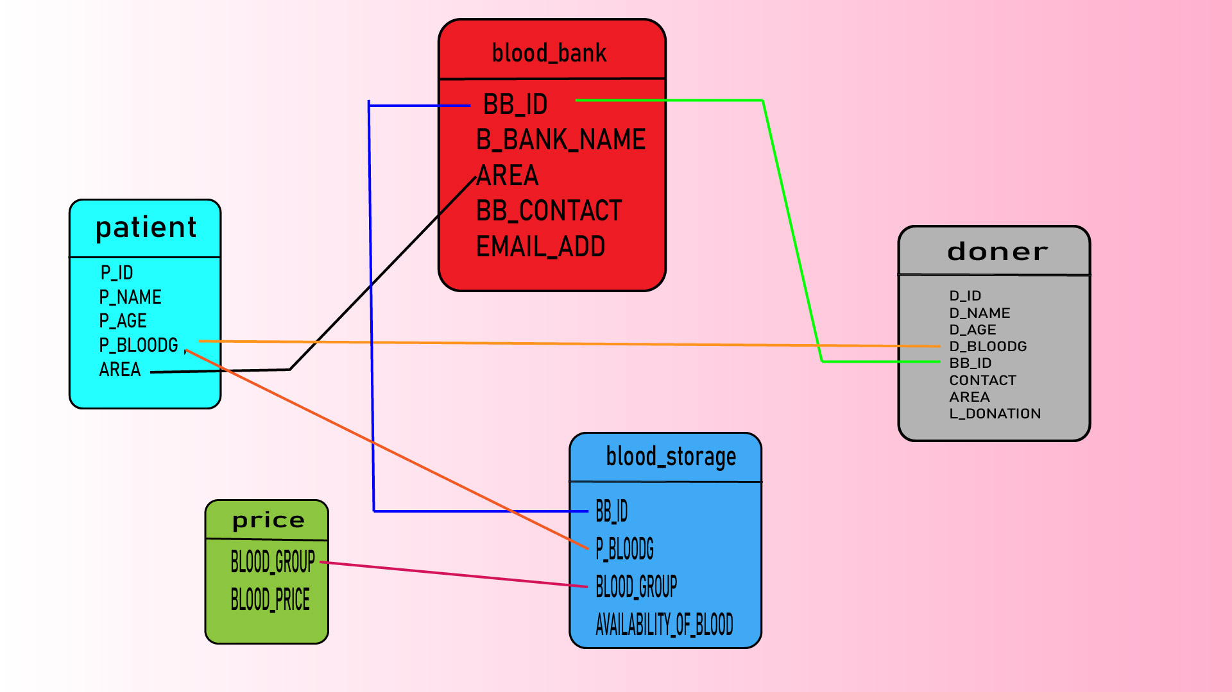
Schema Diagram

Slide 5
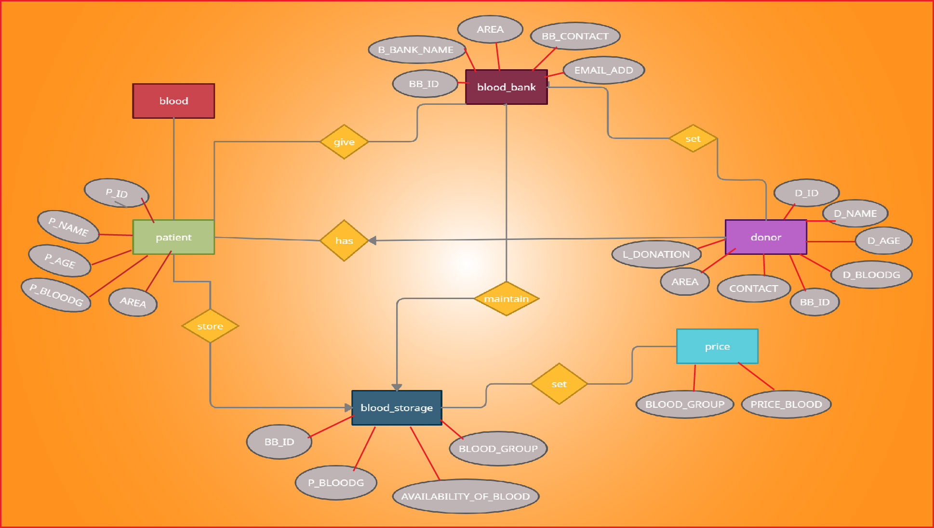
ER Diagram

Slide 6
Table Name | SQL
patient | CREATE TABLE patient ( P_ID VARCHAR(20), P_NAME VARCHAR(15), P_AGE VARCHAR(2), P_BLOODG VARCHAR(3), AREA VARCHAR(20), PRIMARY KEY (P_ID) );
donor | CREATE TABLE donor ( D_ID VARCHAR(20), D_NAME VARCHAR(15), D_AGE VARCHAR(2), D_BLOODG VARCHAR(3), BB_ID VARCHAR(4), CONTACT VARCHAR(11), AREA VARCHAR(20), L_DONATION VARCHAR(10), PRIMARY KEY (D_ID), FOREIGN KEY (BB_ID) );

Slide 7
Table Name | SQL
blood_bank | CREATE TABLE blood_bank ( BB_ID VARCHAR(4), B_BANK_NAME VARCHAR(30), AREA VARCHAR(20), BB_CONTACT VARCHAR(11), EMAIL_ADD VARCHAR(40), PRIMARY KEY(BB_CONTACT,EMAIL_ADD,BB_ID) );
blood_storage | CREATE TABLE blood_storage ( BB_ID VARCHAR(4), P_BLOODG VARCHAR(3), BLOOD_GROUP VARCHAR(3) , AVAILABILITY_OF_BLOOD varchar(3) )
price | CREATE TABLE price ( BLOOD_GROUP VARCHAR(3), BLOOD_PRICE NUMERIC(8,0) );

Slide 8
DML
Table name | P_ID | P_NAME | P_AGE | P_BLOODG | AREA
patient | 19101040 | MOON | 21 | O- | DHAKA-LALBAGH
 | 19101041 | RAHAT | 22 | B+ | RAJHSHAHI-KAJLA
 | 19101042 | MAISHA | 21 | AB+ | FARIDPUR-BUAWALMARI
 | 19101043 | FAYSAL | 47 | AB- | DHAKA-LALBAGH
 | 19101044 | OSMAN | 29 | O+ | FENI-PORSURAM
 | 19101045 | SHAKEEL | 28 | A+ | RAJHSAHI-HATEMKHA
 | 19101046 | HASIB | 37 | A- | BOGURA-GURUSTAN

Slide 9
Table name | D_ID | D_NAME | D_AGE | D_BLOODG | BB_ID | CONTACT | AREA | L_DONATION
donor | 18101040 | NAJMUL | 27 | A+ | 104 | 01795519355 | DHAKA-LALBAGH | 01 JAN 21
 | 18101041 | TUHIN | 56 | A- | 204 | 01795529355 | RAJHSHAHI-KAJLA | 09 MAR 21
 | 18101042 | AISHA | 24 | B+ | 304 | 0175539355 | FARIDPUR-BUWAMARI | 14 FRB 21
 | 18101043 | HAFEEZA | 37 | AB+ | 404 | 01795519351 | BOGURA-GURUSTHAN | 05 APR 21
 | 18101044 | AFIA | 44 | AB- | 504 | 01795519359 | RAJHSHAHI-HATEMKHA | 15 MAR 21
 | 18101045 | JAMEELA | 32 | O+ | 504 | 01795519356 | FENI-PORSURAM | 01 JAN 21
 | 18101046 | ARIF | 29 | O- | 204 | 01795519325 | DHAKA-LALBAGH | 05 APR 21
 | 18101047 | ASRAF | 32 | A+ | 404 | 0195519625 | RAJHSHAHI-HATEMKHA | 07 MAR 21

Slide 10
Table name | BB_ID | B_BANK_NAME | AREA | BB_CONTACT | EMAI_ADD
blood_bank | 104 | Rajshashi Medical College | RAJHSHAHI-KAJLA | 01675686600 | RMC00@gmail.com
 | 204 | Creative Blood Bank | DHAKA-LALBAGH | 01675687800 | CreativeBB78@gmail.com
 | 404 | Faridpur Blood Bank | FARIDPUR-BUWALMARI | 01675686801 | FRDBD68@gmail.com
 | 304 | Mukti Blood Bank | DHAKA-LALBAGH | 01675689800 | Mukti1971@gmail.com
 | 504 | Joynal Abdin Blood Bank | FENI-PORSURAM | 01675687801 | JABB01@gmail.com
 | 104 | Rajshahi Blood Bank | RAJHSHAHI-HATEMKHA | 01675687840 | rbb40@gmail.com
 | 304 | Ratko porisonchalon kendro | BOGURA-GURUSTAN | 01675687102 | roktopk02@gmail.com

Slide 11
Table name | BB_ID | P_BLOODG | AVAILABILITY_OF_BLOOD | BLOOD_GROUP
blood_storage | 104 | A+ | YES | A+,B+,AB+,AB-,O+,O-,A-,B-
 | 204 | AB+ | NO | A+,B+,AB-,O+,O-,A-,B-
 | 404 | B+ | YES | A+,B+,AB-,O+,A-,B-
 | 304 | O+ | YES | B+,AB+,O+,O-,A-,B-
 | 504 | A- | NO | A+,B+,AB-,O+,O-,A-,B-
Table name | BLOOD_GROUP | PRICE_BLOOD
price | A+ | 1000 tk
 | B+ | 800 tk
 | A- | 4020 tk
 | B- | 3500 tk
 | AB+ | 550 tk
 | AB- | 7000 tk
 | O+ | 12500 tk
 | O- | 14550 tk

Slide 12
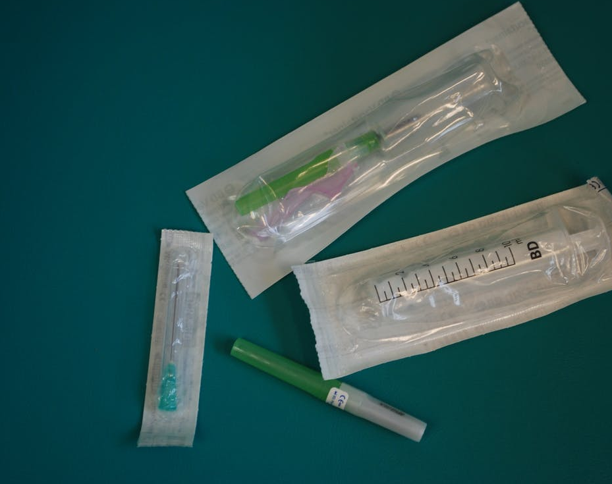
Why Blood Donation Management System
The Blood Donation Management System is a evergreen project for real life.
Blood contains essential life-saving elements that aid the body in the fight against illnesses and injuries. ... It is also important to remember that any one of us may need blood at some point in our lives so, making blood donation an essential duty of our citizenry.
Our motive is to reach Blood in your hand when it's necessary .

Slide 13

T H A N K Y O U

